Slide 1
Accomplish more with macros!
Presenter: Joyce Bell
Princeton University
joyceb@princeton.edu
Notes:
To run simulation: no special keystrokes

Slide 2
Macro Express
Princeton uses Macro Express, a macro utility by Insight Software Solutions
http://www.macros.com/
Notes:
Although I will be talking about macros created using Macro Express, I won’t be demonstrating live macros today. I have simulated the macros, slowing them down to make it easier to follow what they are doing.

Slide 3
Video project
Shortly after Princeton switched to Voyager, we converted a database of around 1,500 video titles into Voyager MARC records using a macro. The macro was run on multiple machines in the computer lab and converted the entire file in a day.
Simulation of video project
Notes:
To run simulation: no special keystrokes
I’m going to start by showing one of our early macros because several of the techniques used it in are a staple of many of our subsequent macros. We had a collection of around 1,500 videos which were listed in an Access database and which we wanted to convert into MARC records. We did some data clean-up in the Access database, created a macro and a Voyager template, and converted the file in the computer lab one day.

Slide 4
Techniques used by the video macro
Variables
  As the macro moved through the Access database, it stored each piece of data in a different variable.
  When the macro moved to Voyager, the data was pasted into the appropriate location(s).
  Data stored in variables can be used multiple times, in any order, and can even be manipulated before use.

Slide 5
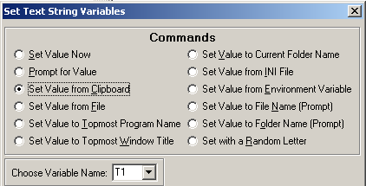
Techniques used by the video macro
To store a variable: highlight the text, copy to clipboard, then set variable from clipboard
<CLIPC><MSD:250><TVAR2:01:03:>

Slide 6
Techniques used by the video macro
Variables
  Using variables to store data for later use allows more flexibility than copying to the clipboard.
  Variables are an extremely useful option not available if you record macros rather than writing them.

Slide 7
Techniques used by the video macro
Wait for window title to appear
  Response times vary for actions like opening, saving, creating and deleting records.
  To prevent the macro from operating too quickly, it is necessary to insert a delay into the macro.
  Writing the macro to “wait for” a particular window title is the safest way to ensure that the delay is long enough (and not too long).

Slide 8
Techniques used by the video macro
Wait for window title to appear
  Waiting for a particular window title involves both a Macro Express command, and a Voyager preference setting.

Slide 9
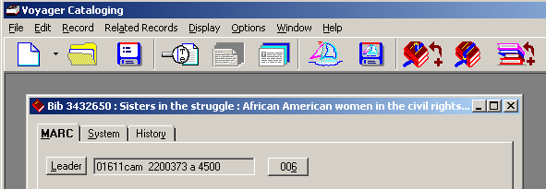
Window title with record minimized
The window title read by the system is “Voyager Cataloging”

Slide 10
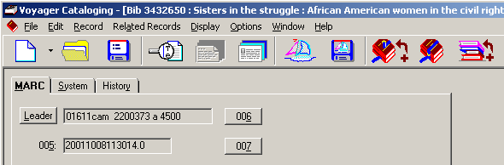
Window title with record maximized
The window title read by the system is “Voyager Cataloging – [Bib 3432650…”

Slide 11
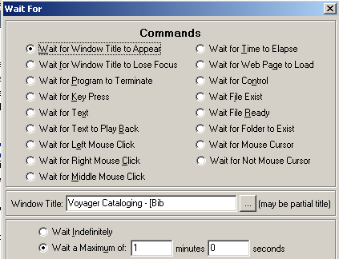
“wait for” commands in MacroExpress

Slide 12
“wait for” commands in MacroExpress
When using a “wait for” command, it is obviously extremely important to make sure that the window the macro is waiting for *will* appear, and that it is the only possible window that can appear.
What windows can appear can be affected by preference settings.

Slide 13
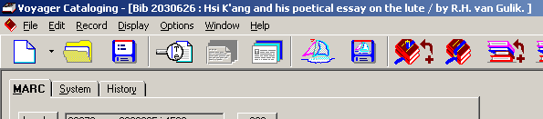


“wait for” commands in MacroExpress
When saving a bib record possible windows that may appear include:
  MARC Error Report
  Authority Validation
  Voyager Cataloging …

Slide 14
Macros and preference settings
Macros have become so integrated into Princeton’s workflows that we have had to dictate some preference settings for our staff.
  The “wait for” window title requires that “Display marc views maximized” be checked.
  Macros which save the bib record, then open or create a MFHD are written assuming that the “Suppress confirmation message upon successful save” option is checked.

Slide 15
Statistics macros
Princeton adopted G. Strawn’s idea of coding data related to cataloging production into a locally-defined MARC field.
We created macros to gather the data we wanted to track and create the MARC field.
The macro ensures consistency—invaluable since the data is machine-extracted and database-“crunched”
Simulation of statistics macro
Notes:
To run simulation: click on menu when it appears, when the no. of items box appears, type 1

Slide 16
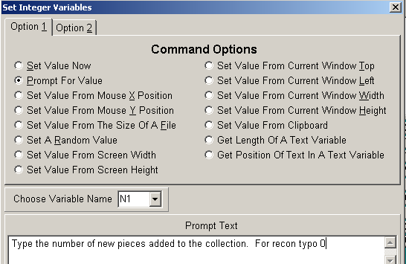
Statistics macros
Variables are used to store info. from leader and no. of pieces
User input can be requested
Simulation
of statistics
macro
Notes:
To run simulation: click on menu when it appears, when the no. of items box appears, type 1

Slide 17
Positioning the cursor
Find keyboard methods for positioning the cursor reliably in an anticipated location.
  Avoid mouse movements—variations in screen resolution and/or window sizing can cause the macro to malfunction

Slide 18
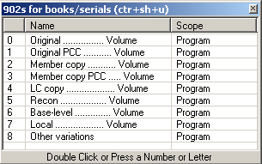
Grouping macros into menus
Using menus to group related macros together limits the number of activation keys your staff has to remember.

Slide 19
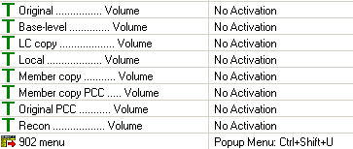
Grouping macros into menus
Macros in a menu can be set to have no activation key of their own …

Slide 20
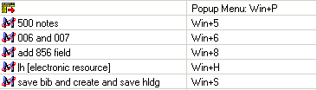
Grouping macros into menus
… or they can be set so they can be activated separately as well as chosen from the menu.
  This is very useful for macros which some staff will use frequently, and others infrequently

Slide 21
BNA macro
Books acquired from our BNA approval plan have records loaded into Voyager--most with LC copy.
We created a macro which will:
  Delete 9xx fields used to create the purchase order
  Add our local cataloging and ordering and statistics fields (902 & 904)
  Mark the record for export
  Create holdings and item records
Simulation of BNA macro
Notes:
To run simulation: click on the Voyager box (to make sure active), type “m” to begin simulation, type “m” when it stops at holdings record, type “m” when it stops at barcode box

Slide 22
BNA macro
This macro demonstrates several of our goals for macro use:
  It replaces keystrokes and mousing
  It speeds up the process
  It enforces a workflow
Simulation of BNA macro
Notes:
To run simulation: click on the Voyager box (to make sure active), type “m” to begin simulation, type “m” when it stops at holdings record, type “m” when it stops at barcode box

Slide 23
Techniques used by the BNA macro
Single activation key
  We use if/then clauses to assign one activation key to a macro (or set of macros) that work through an entire process.
  The if condition relates to the active window title.
Simulation of BNA macro
Notes:
To run simulation: click on the Voyager box (to make sure active), type “m” to begin simulation, type “m” when it stops at holdings record, type “m” when it stops at barcode box

Slide 24
Techniques used by the BNA macro: If/then
<IFOTH:03:2:Voyager Cataloging - [Bib>[commands]<ENDIF>
  If a bib record is the active record, run this set of commands
<IFOTH:03:2:Voyager Cataloging - [Hldg>[commands]<ENDIF>
  If a holdings record is the active record, run this set of commands

Slide 25
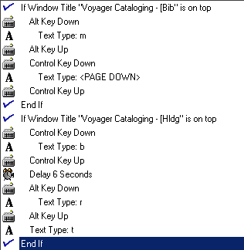
Techniques used by the BNA macro:
If/then

Slide 26
If/then
If an entire macro is encased in an if/then command linked to a window title, you can ensure that the macro will not be able to run in inappropriate situations.
Note: using if/then clauses related to the window title requires that MARC views be displayed maximized.

Slide 27
Techniques used by the BNA macro:
Repeat, clipboard compare
How does our BNA macro delete the 9xx fields?
First the macro must find fields from 900 to 999
  Using the “repeat” function
  Using the clipboard compare function
[live V manual run-through of process]

Slide 28
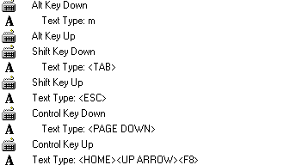
Techniques used by the BNA macro:
Repeat, clipboard compare
First the cursor is reliably positioned at the end of the record in the tag field with the cursor activated.

Slide 29
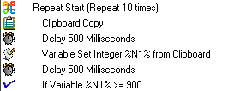
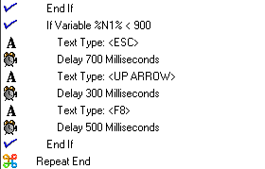
Techniques used by the BNA macro:
Repeat, clipboard compare
Next, a repeat cycle is started which will copy the tag to the clipboard, save it as a variable, and compare the variable with our condition.

Slide 30
Repeat, clipboard compare
Simulation of macro which starts from the first tag in the record and works down until it finds a 650 field
Notes:
To run simulation: click in Voyager box (to make sure it is active), type “m” to start macro

Slide 31
“Looping” a macro on itself
If/then clauses related to the window title can also be used to perform a set of actions continuously until the ‘if’ condition is no longer met.
  Example: Change the location code to “f” for all open item records.
  Simulation of “looping” macro
Notes:
To run simulation: wait for the simulation of the “manual” part to stop (when all item records are open), then activate the macro by typing “m”

Slide 32
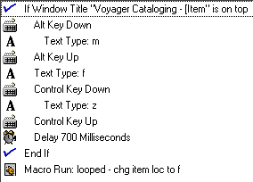
“Looping” a macro on itself
Enclose all actions in an if/then clause, except a final command to run the macro

Slide 33
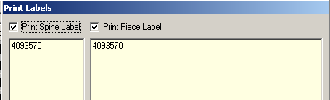
Getting the bib id number
We have come up with two methods:
  Configuring the print label (which we don’t otherwise use) to show the id number and copy it from there.
  (…/Misc/Spinelabel.cfg)

Slide 34
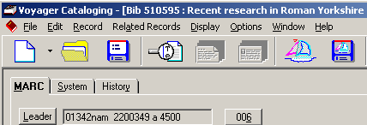
Getting the bib id number
  The second method we came up with was to get the bib id from the window title.

Slide 35

Getting the bib id number
  First save the window title into a variable. Macro Express has a command to do this.

Slide 36
Getting the bib id number
The variable stores the entire text string:
Next, delete 26 characters from the beginning. This will strip all data before the bib id number.

Slide 37
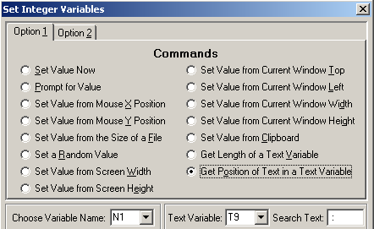
Getting the bib id number
Then find the numeric position of the [space] : in the variable

Slide 38
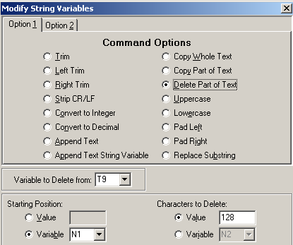
Getting the bib id number
Finally, delete data from the variable starting from this numeric position.

Slide 39

Getting the bib (or mfhd) id number
<TVAR2:09:06:><TMVAR2:11:09:00:001:026:><IVAR2:01:13:9: _x0001_><TMVAR2:11:09:00: N01:128:>
Note: getting the mfhd id number is similar, but the number is followed by [space] ( rather than [space] :

Slide 40
Tips
Limit the number of activation keys by:
  Grouping macros into menus
  Using if/then and window titles to allow a single macro to function differently according to circumstance
If you can’t figure out why a new macro doesn’t work, try adding delays.
Test, test, test!

Slide 41
Things to avoid
Mouse movements
  When unavoidable, relate them to the active window, or to cursor position
Recording macros
Assigning macros to keys used by Windows or Voyager
Creating macros for functions which can be easily performed with existing keyboard commands

Slide 42
Accomplish more with macros!
Questions?

